Slide 1



2026
Mearas Technologies
Customized
AI-Driven Sales Process Automation for Discrete Manufacturing

Slide 2
2026
What we do
We build customized software applications to automate complex Sales and quotation management processes for companies in the discrete manufacturing industry, including Engineered-to-Order & Made-to-Order type businesses.
The applications we build are customized ground-up to meet each customer’s unique processes
Our ‘mini-applications’ specifically focus on leveraging AI algorithms to automate complex Bill-of-Material planning, creation, product configuration, costing, quote automation and executive KPI dashboards.

Slide 3
We can help you if...
01 02 03 04
It takes a long time to respond to customers due to time consuming processes involving Bill-of-material (BOM) planning, product configuration and proposal creation
For need of automation and structured data, your Sales team is spending more than desired ‘desk time’ manually – to collect data, to work on costing, and to write technical & commercial proposals
Your Excel based or legacy systems are not delivering on speed and accuracy on BOM planning, product configuration & proposal creation
You lack integration of your current BOM, configuration and proposal automation systems are not integrated with key functions such as Finance, Engineering, Materials, Manufacturing etc.

Slide 4
We can help you if...
05 06 07 08
You are paying high license costs for off-the-shelf products while the functionality & workflows are not tailored to your unique processes
You feel an acute need for an integrated system that is tailored for your unique sales processes
You are experiencing high Total Cost of Ownership (TCO) on the current systems
Delays, issues in accuracy, slower decision making etc. are impacting your competitiveness

Slide 5

01
How our ‘mini-apps’ impact your business
Enhance efficiency in integration & alignment between your Sales, Engineering, Costing & other relevant functions
02
Our goal is to help reduce your complex sales process cycle times, enabling faster response to customers and shorter customer acquisition cycle times
Increase speed of proposal creation & submissions, hence enable higher volume of closures
03
100% configured to your unique BOM creation, product configuration, costing & proposal processes. No generic functionality
04
Strong workflows and real-time data & analysis at all levels of decision influencing & decision making process. Enabling faster & effective decisions

Slide 6
01
What our ‘mini-apps’ are
Customized AI-driven automation of your complex ETO/MTO/Product BOM creation & Product configuration process
02
Our goal is to help reduce your complex sales process cycle times, enabling faster response to customers and shorter customer acquisition cycle times
Workflow enabled and integrated Proposal Automation system that is customized to suit your unique processes
03
Algorithm based ‘Data extractor’ system to give your sales team ‘qualified data sets’ for effective & faster lead generation, with lead scoring & probability analysis
04
AI-powered executive dashboard with customized metrics & UI/UX, drawing real-time data for reporting & analysis. Enabling faster decision making

Slide 7
Our Advantages
Our goal is to help reduce your complex sales process cycle times, enabling faster response to customers and shorter customer acquisition cycle times
01
02
03
04
Quick deployment of each app – from requirements to development to Go-live
No front loading of investment. You pay per app. No large end-to-end implementation
Configure the system functionality & workflows, progressively, with minimum development efforts
Seamless integration with your other existing systems such as ERP, CRM, Finance, Manufacturing etc.

Slide 8
6 Core modules
01
BOM Creation
02
Product Conﬁguration
03
Costing Engine
04
Quote Automation
05
Legal And Contract Review
06
Executive KPI Dashboard

Slide 9
4 Core foundations of Reusable Component Framework
01
02
03
04
Conﬁguration Algorithm
Integrated API Architecture
Sales Order Workﬂow
UI/UX Portal Framework
Ensures secure, scalable integration across enterprise-wide systems and services
Automates order processing with conﬁgurable rules and dynamic pricing
Intuitive, user-tested interfaces designed for rapid adoption across teams
Dynamically adjusts rules and workﬂows to meet changing requirements

Slide 10

BOM Creation
AI-Driven BOM Creation
01 02 03 04
AI-Optimized Component Selection
Business Challenge
Automates part selection for accurate assembly integration
Standardized BOM Templates
Enforces consistent hierarchical structures across product variants
Manual BOM creation sometimes faces mismatched components, inconsistent templates, production plan delays, higher costs, and supply chain gaps.
Real-Time Costing
Mearas’ AI-driven BOM uses smart algorithms to ensure accuracy in product selection, design and costing.
Calculates part and assembly costs instantly for accurate quotes
Inventory and Availability Check
Veriﬁes stock levels and supplier lead times to prevent procurement delays

Slide 11
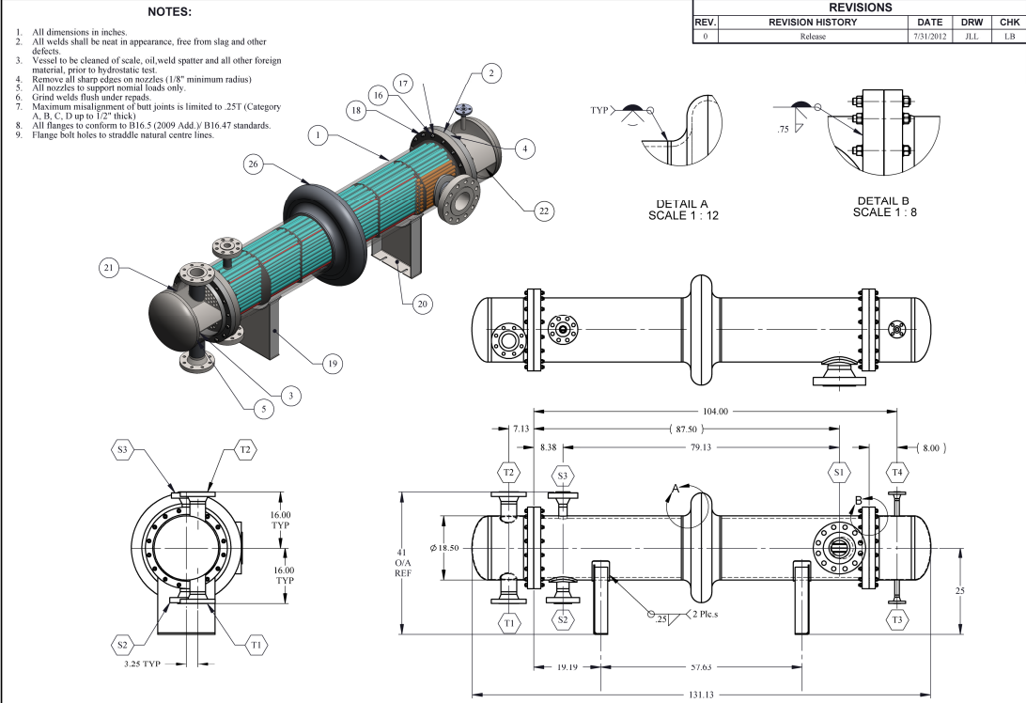
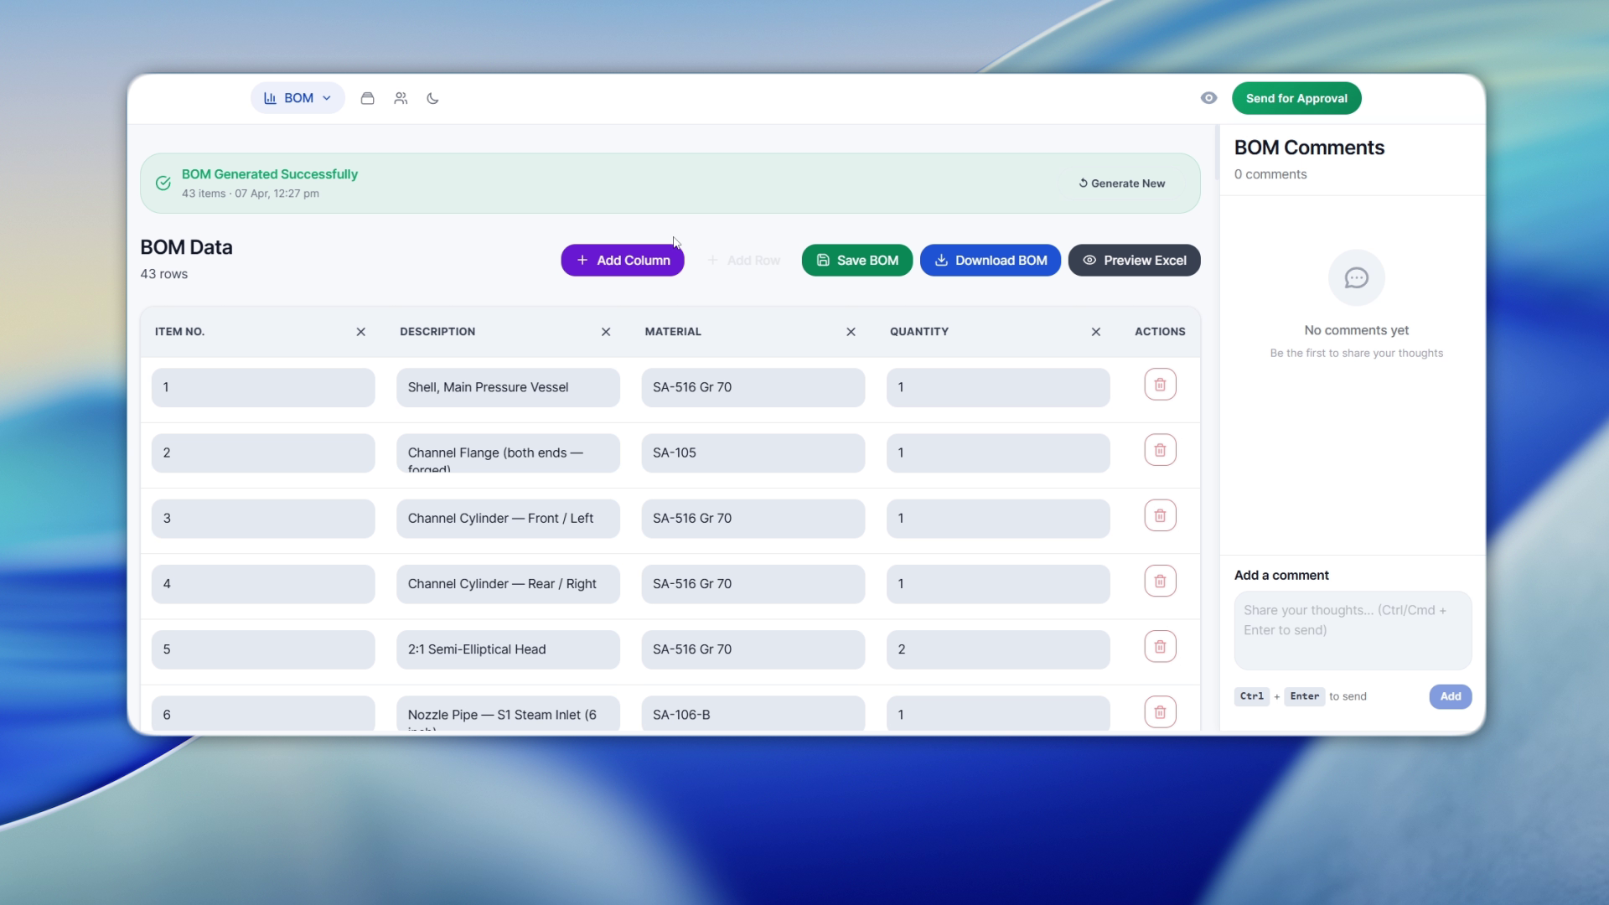
BOM Creation
Heat Exchanger Drawing
Generated BOM

Slide 12
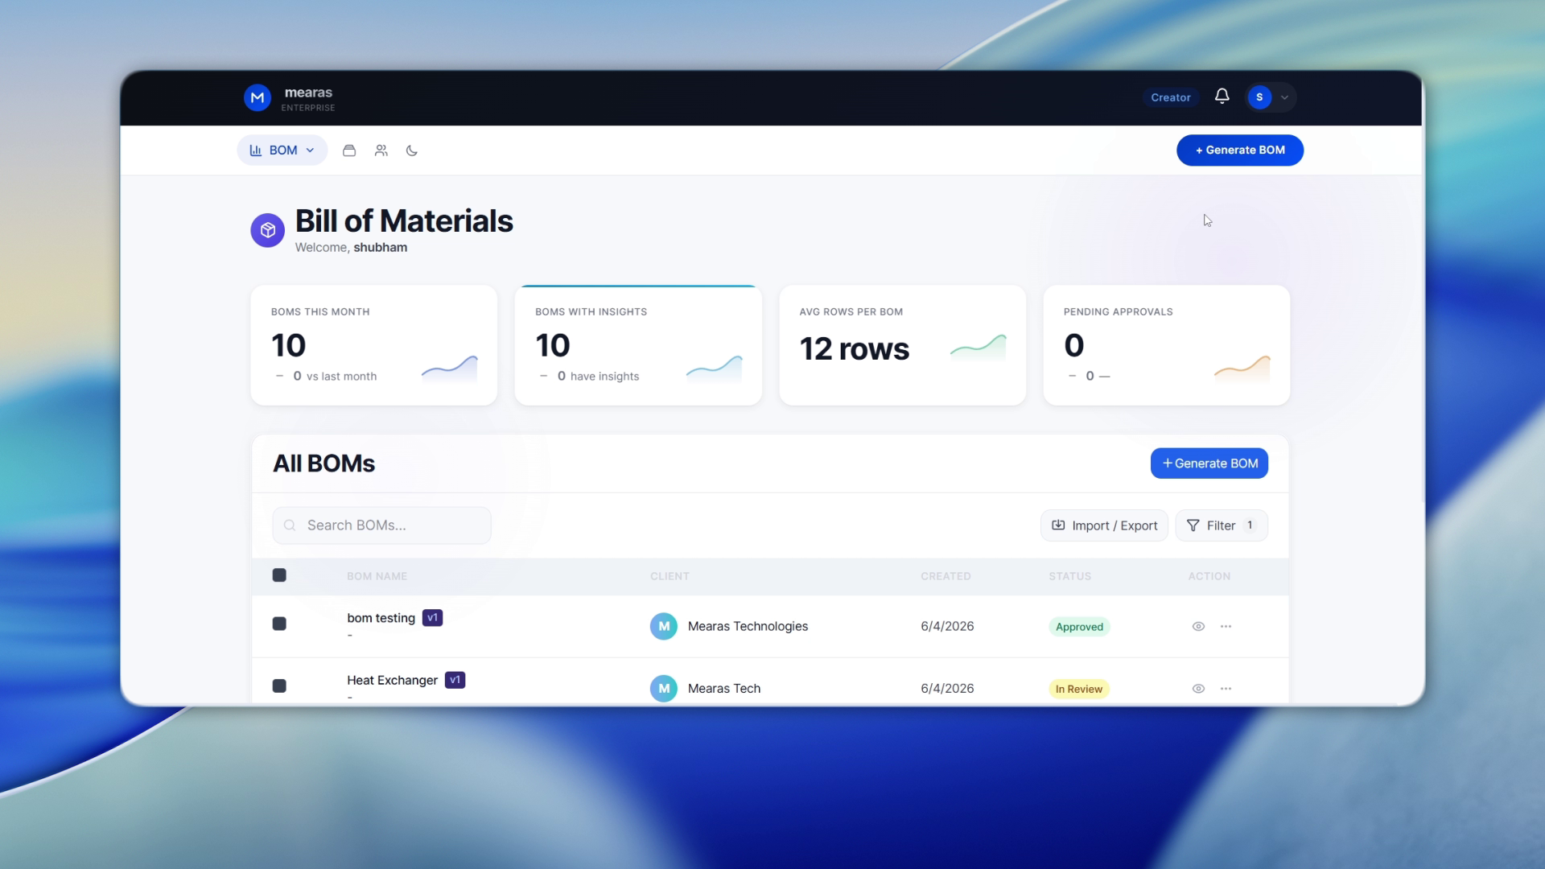
BOM Dashboard

Slide 13
Product Configurator
Product Configurator
01
Rule-Based Configuration Engine
Business Challenge
Applies your product's engineering rules, dependencies and constraints automatically
02
Variant & Option Management
In ETO and MTO businesses, configuring the right product variant for each customer enquiry is time-consuming, error-prone and heavily dependent on senior engineering knowledge — slowing down RFQ response and risking costly specification mistakes.
Handles complex product variants, optional features and customer-specific customizations within a structured framework
03
Configuration-to-BOM Handoff
Seamlessly passes the confirmed product configuration directly into BOM creation and costing workflows

Slide 14
Costing Engine
Costing Engine
01 02 03 04
Business Challenge
Historical Cost Intelligence
Trained on your own past costing data to predict accurate cost estimates for new enquiries
Live Material Price Integration
Building an accurate cost for a complex engineered product is a slow, manual process — involving multiple spreadsheets, dependencies on costing engineers and constant back-and-forth with procurement for material prices. Errors at this stage directly impact margins.
Pulls current commodity and component prices in real time
Multi-Level Cost Build-Up
Mearas' AI-driven Costing Engine learns from your historical cost data, live material prices and labour norms — delivering accurate, multi-level cost build-ups in minutes with full margin visibility and auditability..
Automatically structures costs across raw material, sub-assembly, labour, overhead and margin levels
Margin & Variance Analysis
Enhances forecasting accuracy and shortens sales cycles time

Slide 15
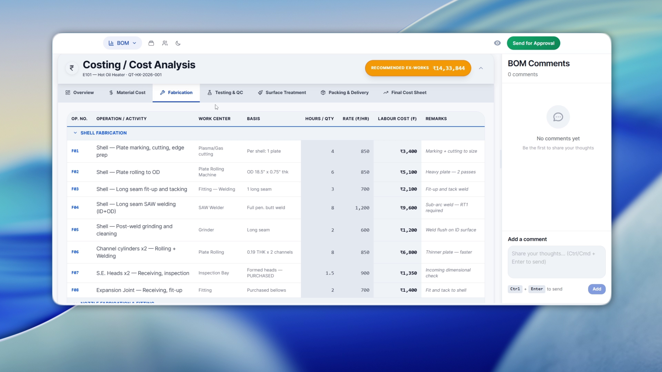
Costing Engine
AI Generated Costing Sheet

Slide 16
Quote/Legal & Contract
Quote/Legal & Contract
01 02 03 04
Automated Drafting
Business Challenge
Generates quotes directly from CRM/ERP data with minimal manual input
Dynamic Customization
Tailors pricing, product bundles, and terms to client proﬁles and deal size
Sales teams invest excessive time in quote creation and term customization, resulting in delays, errors, limited scalability, and missed opportunities.
Mearas’ Quote/Legal & Contract automation generate
accurate, compliant, client-speciﬁc quotes rapidly.
Version Control
Ensures consistent formatting, branding, and compliance across quotes
E-Signature Integration
Accelerates closure by embedding secure digital
signing options

Slide 17
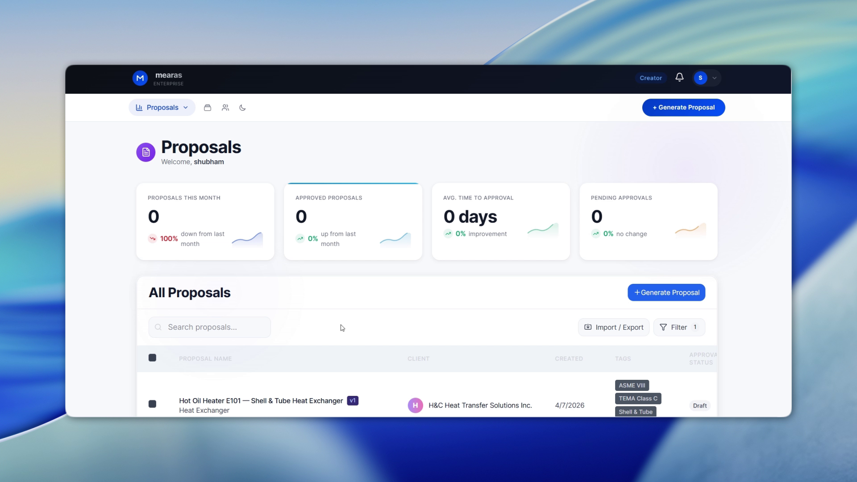
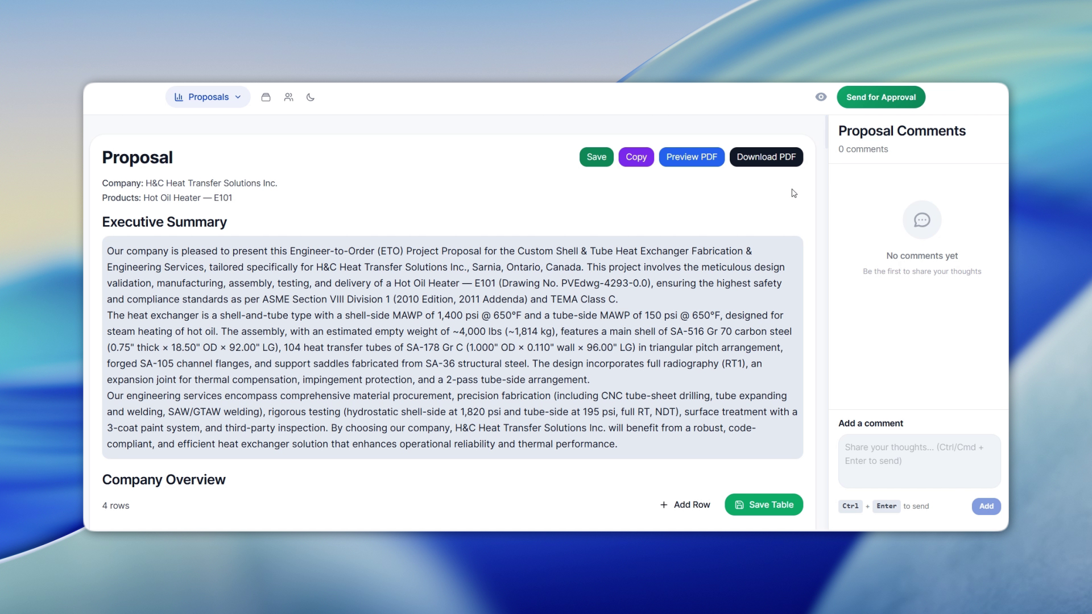
Quotation Creation
Quotation Dashboard
Quotation Generator

Slide 18
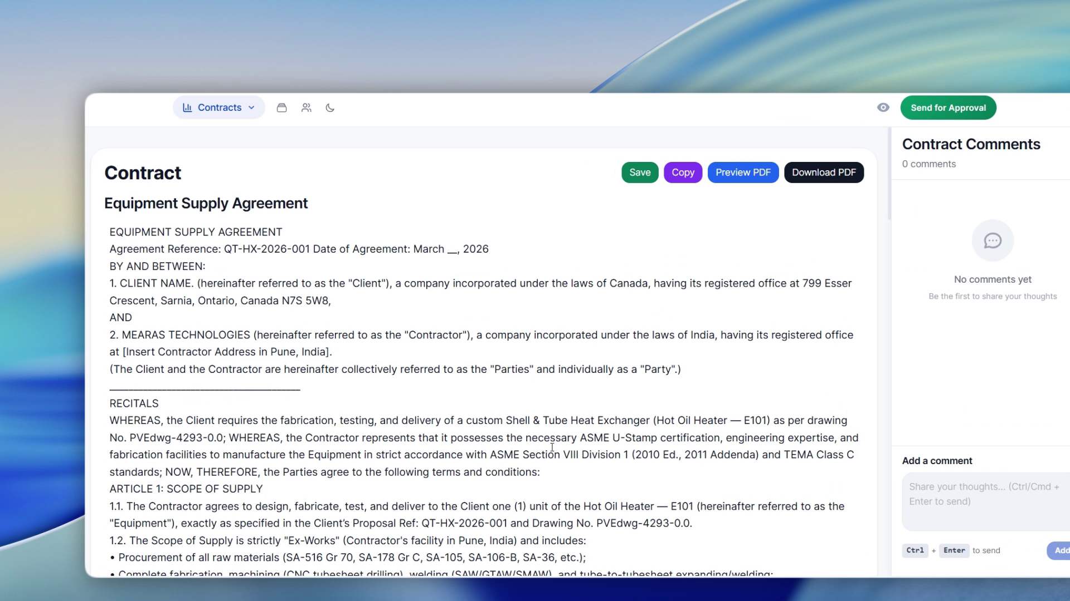
Contract Review
Legal / Contract Review

Slide 19
KPI Dashboard
KPI Dashboard
01 02 03 04
RFQ & Quote Cycle Tracking
Business Challenge
Monitors RFQ-to-quote turnaround time by product, team and customer
Cost vs. Actuals Variance
Sales leaders in ETO and MTO businesses are flying blind — pipeline data lives in spreadsheets, RFQ status is tracked over email and WhatsApp, and by the time leadership gets a report it is already outdated.
Compares quoted costs against actual production costs order by order
Production tracking
Connects sales order data with production schedules, delivery milestones and on-time fulfilment rates
Mearas’s Manufacturing Sales KPI Dashboard gives every level of your organisation — from sales engineer to MD — a single, real-time view of the metrics that drive order wins and revenue in an industrial sales environment.
Order Fulfilment Tracking
giving leadership a live view from order booking to dispatch. Bridges the gap between what was sold and what was delivered

Slide 20
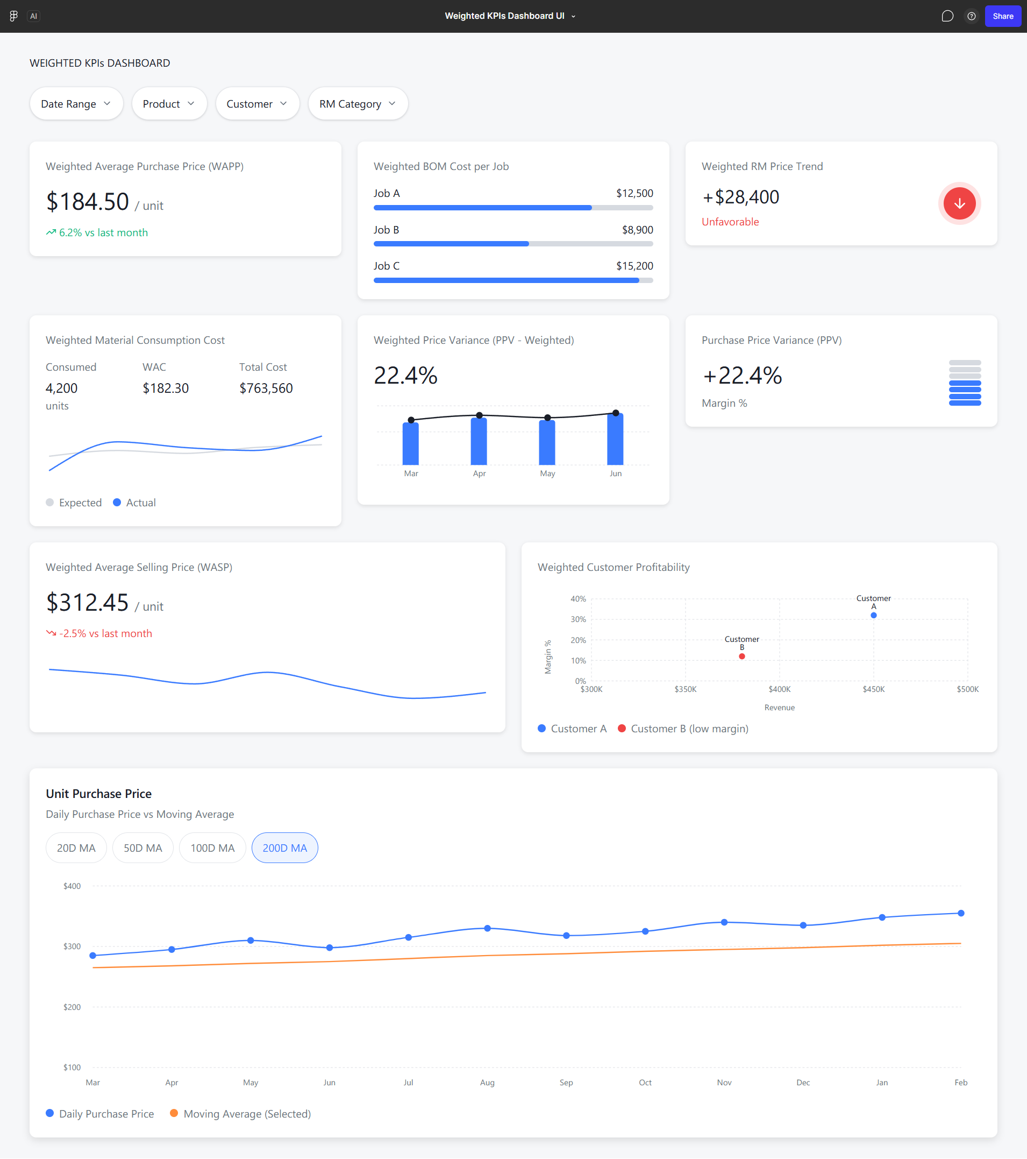
KPI Dashboard
Manufacturing KPI Dashboard

Slide 21
2026
CONTACT US
smohite@mearastec.com
www.mearastec.com

